Slide 1

Cloud based payment systems vs blockchain based payment systems supervisor: Dr. arun kumar Tripathi
-By Chirag Tyagi, Divyanshu, Astha Chauhan

Slide 2
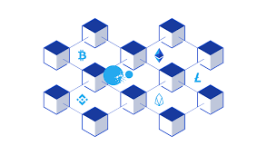
BLOCKCHAIN?
Blockchain is a shared, immutable ledger
that facilitates the process of recording
transactions and tracking assets in a
business network.
Virtually anything of value can be tracked
and traded on a blockchain network,
reducing risk and cutting costs for all
involved.

Slide 3
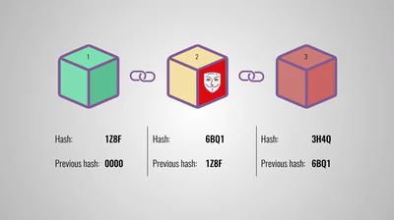

Slide 4
SMART CONTRACTS
To speed transactions, a set of rules —
called a smart contract — is stored on
the blockchain and executed automatically
A smart contract can define conditions
for corporate bond transfers, include
terms for travel insurance to be paid and
much more.

Slide 5
SMART CONTRACTS IN TRANSACTION

Slide 6
BENEFIT TO SOCIETY Transactions using smart contracts will make the process fast, secure and free from any middlemen thus providing a better experience to the users. OUTCOME OF RESEARCH We are focussing on submitting our project in Scopus Conference (IEEE/Springer) and in Scopus Journal.
AIM
To make the process of transaction fast, cheap and more secure for the users using blockchain and smart contracts.

Slide 7
OBJECTIVE
Our system uses blockchain that allows online transactions which enables online payments to be sent directly from one party to another without going through a financial institution and in a secured way. This system allows online transactions between two parties based on cryptographic proof without relying and trusting for a third party

Slide 8
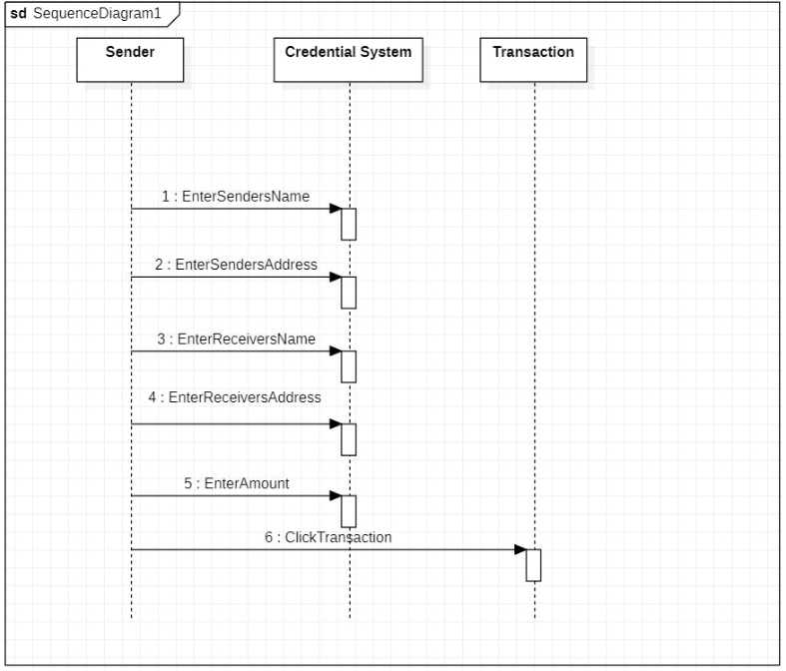
SEQUENCE DIAGRAM

Slide 9
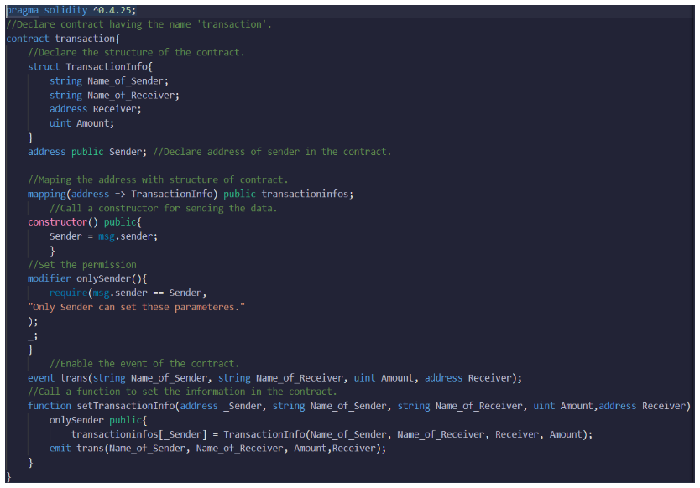
SMART CONTRACT

Slide 10
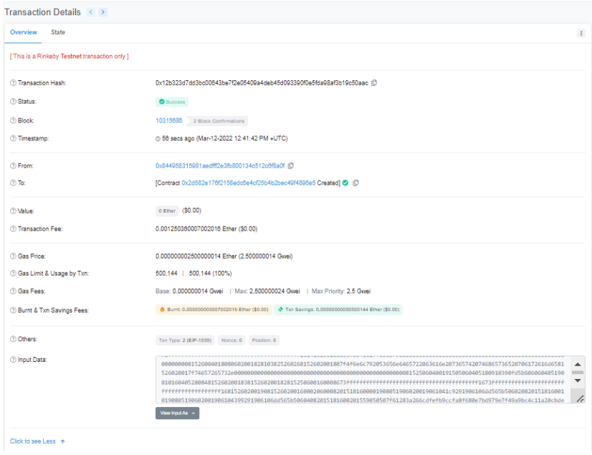
OUTCOME

Slide 11
OUTCOME
We are focussing on submitting our project in Scopus Conference (IEEE/Springer) and in Scopus Journal.

Slide 12


